Slide 1
DATE METHODS
IN JAVASCRIPT

Slide 2
What is a Date?
A Date object in JavaScript is used to work with dates and time. It helps us get the current date and time or change it whenever needed.
Why do we use Date?
Date methods help us:
• Display the current date and time.
• Get the day, month, and year.
• Change the date or time.
• Build calendars, clocks, reminders, and scheduling systems.
DATE METHODS
Date methods are built-in JavaScript functions that help us get or change different parts of a date and time.

Slide 3
METHODS
1. new Date()
2. toDateString()
3. getDate()
4. getMonth()
5. getFullYear()
6. getDay()
7. getHours()
8. getMinutes()
9. getSeconds()
10. getMilliseconds()
11. setDate()
12. setMonth()
13. setFullYear()
14. setHours()
1. new Date()
The new Date() constructor creates a new Date object with the current date and time.

Slide 4


First, new Date() gets the current date and time from the computer and stores it in the variable today. Then document.write() displays the complete date and time on the webpage.
2. toDateString()
This method displays only the date in a simple and readable format.
This method removes the time from the Date object and shows only the day, month, date, and year.
3. getDate()
This method returns the current day of the month.
This method reads the Date object and returns only the date.

Slide 5



4. getMonth()
This method returns the current month as a number.
a
JavaScript starts counting months from 0, so January is 0, February is 1, and December is 11. If you want the actual month number, add 1.
5. getFullYear()
This method returns the current year.
6. getDay()
This method returns the day of the week

Slide 6


This method returns the day as a number from 0 to 6. Sunday is 0, Monday is 1, and Saturday is 6.
7. getHours()
This method returns the current hour.
This method gets the hour from the current time. It uses the 24-hour clock, so 4 PM is shown as 16.
8. getMinutes()
This method returns the current minutes.
This method gets only the minutes from the current time and displays them.

Slide 7
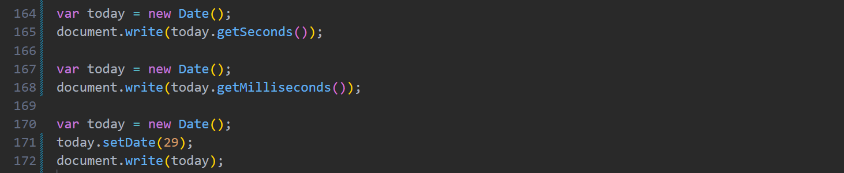
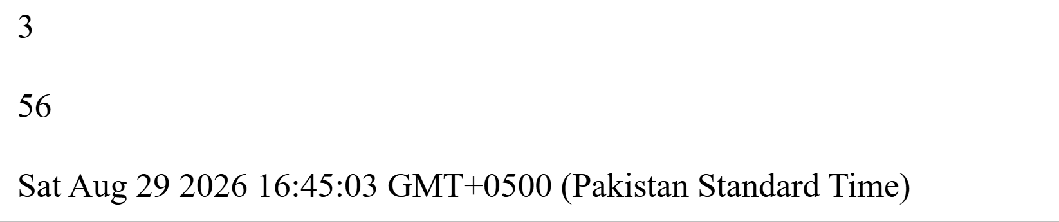
9. getSeconds()
This method returns the current seconds.
10. getMilliseconds()
This method returns the milliseconds of the current time.
11. setDate()
This method changes the day of the month.

Slide 8
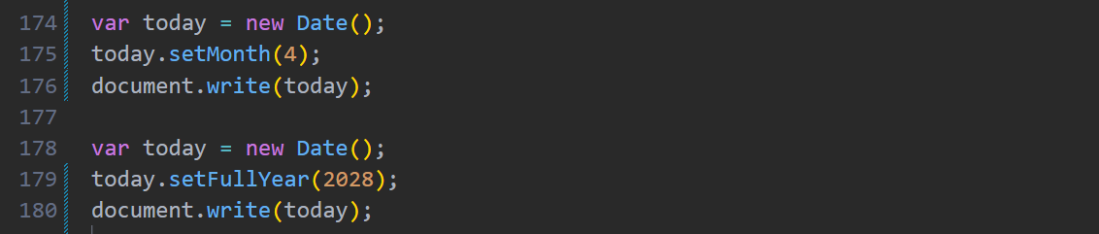
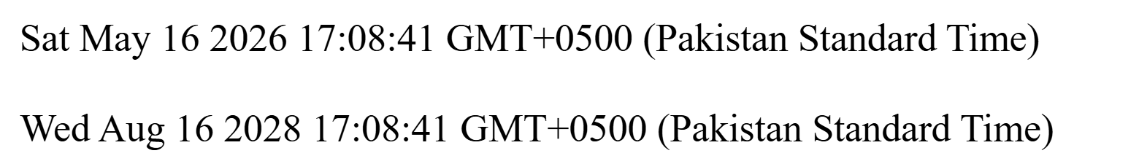
This method changes the date to 29 while keeping the month and year the same.
12. setMonth()
This method changes the month.
13. setFullYear()
This method changes the year.

Slide 9
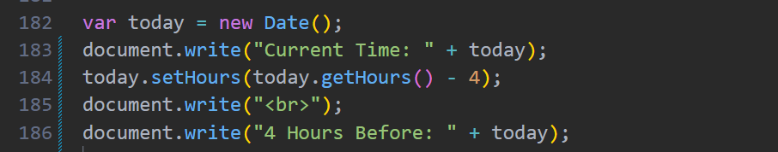
14. setHours()
The setHours() method is used to change the hour value of a Date object. It can also be used to calculate a previous or future time by changing the hour.
First, new Date() stores the current date and time. The getHours() method gets the current hour, and setHours() changes it by subtracting 4 hours. This gives us the time that was exactly 4 hours before the current time.

Slide 10
THANK YOU

